Slide 1
BIOS 255 — Week 4
Lymphatic System
Focus Guide
Use it to focus your study — not to replace reading the lecture.
Laura Bates, DC · BIOS 255

Slide 2
Section 1
Lymphatic System — Overview & Functions

Slide 3
Functions of the Lymphatic System
Lecture Slides 3 & 9
Three Core Functions
What Is Lymph?
Fluid Recovery — absorb excess interstitial fluid; 85% returns via blood capillaries, 15% via lymphatics
Immunity — immune surveillance at lymph nodes, tonsils, and spleen; filter pathogens
Lipid Absorption — lacteals in small intestine absorb dietary fats (chyle)
Filtered extracellular fluid — mostly water + electrolytes
Normal lymph: clear to pale yellow; intestinal lymph (chyle): milky white; infected lymph: cloudy
Contains fewer plasma proteins than blood
May carry lymphocytes, pathogens, cancer cells
NOT pumped by the heart — low-pressure system
Exam focus: know all three functions; know how lymph composition differs from plasma; know chyle vs. normal lymph color.

Slide 4
Section 2
Lymphatic Vessels, Flow & Transport

Slide 5
Lymphatic Vessels — Structure & Characteristics
Lecture Slides 5 & 6
Closed/blind-ended capillaries — fluid enters but CANNOT flow backward
Overlapping endothelial cells act as one-way flaps; open when interstitial pressure is HIGH
NOT found in: cartilage, cornea, bone, bone marrow
Like veins: low pressure, valves prevent backflow, skeletal muscle pump, respiratory pump assist movement
Unique feature: large gaps between endothelial cells allow bacteria and immune cells to enter
If blocked → fluid accumulates → EDEMA
Key distinction: lymphatic capillaries are blind-ended (unlike blood capillaries). Valves prevent backflow — same concept as veins.

Slide 6
Lymphatic Flow Pathway
Lecture Slides 6 & 7
Step 1: Lymphatic capillaries absorb interstitial fluid
Step 2: Capillaries → larger collecting vessels
Step 3: Collecting vessels → lymphatic trunks (jugular, subclavian, bronchomediastinal, intestinal, lumbar)
Step 4: Trunks → collecting ducts (two major ducts)
Step 5: Ducts empty into subclavian veins → returns to bloodstream
Right lymphatic duct: drains right arm, right side of head & thorax → right subclavian vein
Thoracic duct: drains EVERYTHING ELSE (below diaphragm via cisterna chyli, left arm, left head/neck/thorax) → left subclavian vein
High-yield: know the full sequence AND the asymmetry — the thoracic duct drains most of the body. Cisterna chyli = where intestinal lymph collects before entering thoracic duct.

Slide 7
Lymph Transport — How Lymph Moves
Lecture Slide 9
Lymphatic system has NO pump — relies entirely on external forces
Skeletal Muscle Pump: muscle contractions compress lymph vessels → moves lymph forward; valves prevent backflow
Respiratory Pump: thoracic pressure drops on inhalation → pulls lymph upward into great vessels
Pulsations of nearby arteries and smooth muscle contractions in vessel walls also assist
Clinical: immobility and bed rest impair lymph flow → edema; early ambulation restores drainage
Know both pumps by name and mechanism. The same pumps move venous blood — a common connection question.

Slide 8
Section 3
Lymphatic Tissues & Cells

Slide 9
Lymphatic Tissues & Cell Types
Lecture Slides 11 & 13
Lymphatic Tissues
Lymphoid Cell Types
NO capsule — distinguishes tissue from organs
Mucosa-Associated Lymphatic Tissue (MALT): scattered in digestive, respiratory, urinary, and reproductive tracts
Lymphatic nodules (follicles): temporary dense masses that form in response to pathogens
Peyer's Patches: aggregated lymph nodules in small intestine wall — gut immune surveillance
T cells (lymphocytes): attack viruses and parasites inside host cells — cell-mediated immunity
B cells (lymphocytes): produce plasma cells → secrete antibodies — humoral immunity
Macrophages: phagocytize foreign substances; help activate T cells
Dendritic cells: capture antigens, deliver to lymph nodes, activate T cells
Reticular cells: produce structural scaffolding (stroma) in lymphoid organs
Know the difference between T cells (cell-mediated) and B cells (humoral/antibody-producing). MALT = frontline surveillance at body openings.

Slide 10
Section 4
Primary Lymphatic Organs — Where Lymphocytes Are Made

Slide 11
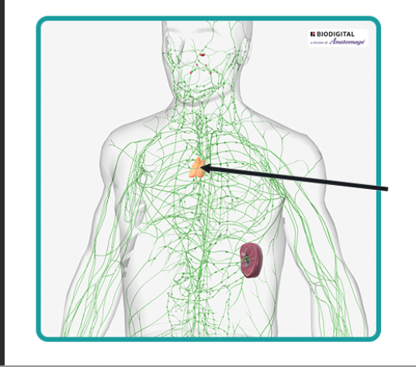
Primary Organs: Red Bone Marrow & Thymus
Lecture Slides 15, 16 & 17
Red Bone Marrow
Thymus
Located in: flat bones (pelvis, ribs, skull, vertebrae) and epiphyses of femur & humerus
In children: fills nearly all bones
Site of hematopoiesis — produces ALL blood cells including lymphocytes
Site of B-cell maturation
Clinical: bone marrow aspiration used to diagnose leukemia, aplastic anemia, myelodysplastic syndromes
Located in mediastinum — behind sternum, in front of aortic arch
Plays roles in endocrine, immune, AND lymphatic systems
Site of T-cell maturation — only ~25% of T cells survive selection
Most active during childhood and adolescence
Involutes with age: shrinks from ~70g to ~3g, replaced by adipose tissue
Removal/damage → T-cell immunodeficiency (e.g., DiGeorge syndrome)
Primary = maturation sites. Bone marrow = B cells; Thymus = T cells. The thymus is most active in childhood — know why.

Slide 12
Section 5
Secondary Lymphatic Organs — Where Immune Responses Happen

Slide 13
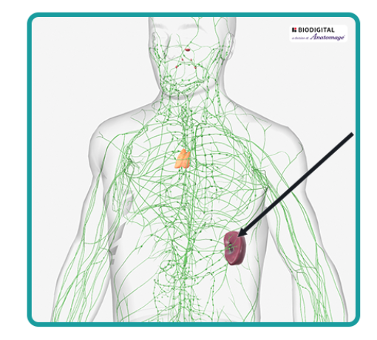
Tonsils & Spleen
Lecture Slides 19, 27 & 28
Tonsils — Three Pairs
Spleen
Palatine: posterior oral cavity — most often infected; removed in tonsillectomy
Lingual: at base of tongue
Pharyngeal (Adenoids): on wall of nasopharynx
Together form Waldeyer's Ring — defensive circle around upper respiratory/digestive openings
Functions: trap/filter inhaled and ingested pathogens; immune surveillance
Largest lymphatic organ — upper left abdominal quadrant
Only lymphatic organ that filters BLOOD (not lymph)
Red pulp: destroys old/damaged RBCs (erythrocyte graveyard); stores up to ⅓ of platelets
White pulp: lymphocytes and macrophages; immune surveillance; fights encapsulated bacteria
Removal/rupture → serious risk; post-splenectomy patients need vaccinations for encapsulated bacteria (pneumococcus, meningococcus, H. influenzae)
Example: spleen = RBC graveyard (red pulp) AND immune surveillance (white pulp). Thyroid is NOT a lymphatic organ.

Slide 14
Lymph Nodes — Structure & Function
Lecture Slides 20 & 21
Most numerous lymphatic organs (~450 in the body)
Filter and clean lymph as it travels back to the bloodstream
Site of T-cell and B-cell ACTIVATION (secondary lymphatic function)
Structure: bean-shaped with a hilum; fibrous capsule divides internal compartments
Afferent vessels bring lymph IN → Efferent vessels carry filtered lymph OUT through the hilum
Outer Cortex: B cells, germinal centers (enlarged during active infection)
Inner Cortex: T cells and dendritic cells
Medulla: lymphocytes, plasma cells (antibody producers), macrophages
Know the flow direction: afferent IN → cortex → medulla → efferent OUT at hilum. Germinal centers = sign of an active immune response.

Slide 15
Section 6
Regional Lymph Node Locations

Slide 16
Lymph Node Locations — Know the Drainage Territories
Lecture Slides 22 & 23
Node Location | Region Drained | Clinical Significance
Cervical | Head & neck | Upper respiratory infections, dental infections
Axillary | Upper limb & breast | Breast cancer staging
Mammary | Breast tissue | Breast cancer — look for axillary/mammary enlargement
Thoracic / Mediastinal | Chest, airways, lungs | Lower respiratory infections
Mesenteric / Intestinal | Digestive tract | GI infections, appendicitis; can mimic appendicitis
Inguinal | Lower limbs, groin | STIs, lower limb infections
Popliteal | Foot & lower leg (crural) | Foot/lower leg infections
Example: you may be asked to identify a node from an image or match a node to its drainage territory (i.e. Mammary nodes drain lymph from where? Why important?)

Slide 17
Section 7
Lymphatic Dysfunction & Cancer Metastasis

Slide 18
Lymph Node Enlargement — Infection vs. Cancer
Lecture Slides 16 & 17
Feature | Infection (Reactive) | Cancer (Malignant)
Tenderness | Tender / painful | Non-tender
Texture | Soft to rubbery | Hard, firm, stone-like
Mobility | Freely movable | Fixed or matted
Onset | Rapid / acute | Slow, insidious
Skin changes | Warm, erythematous | None
Regression | Often resolves after infection | Progressively enlarging
High-yield table. These features are clinically tested. Size >2 cm is concerning for malignancy.

Slide 19
Metastatic Cancer & Lymphatic Dysfunction
Lecture Slides 25 & 26
How Cancer Spreads via Lymph
Lymphatic Dysfunction Consequences
Cancer cells enter permeable lymphatic vessels from primary tumor
Transported to the nearest (sentinel) lymph node
Nodes become: firm, enlarged, non-tender, fixed
Cells multiply and eventually destroy the node
Can re-enter bloodstream → spread to distant organs
Example: colon cancer → mesenteric nodes → intestinal trunk → cisterna chyli → thoracic duct → bloodstream
Blocked lymphatic vessels → fluid buildup → EDEMA (not autoimmunity, not anemia)
Removed spleen → immunodeficiency (loss of blood-filtering immune organ)
Damaged thymus → T-cell immunodeficiency
Thoracic duct blocked → fluid accumulates in areas below the diaphragm AND left upper body (most of the body)
Right lymphatic duct blocked → right arm, right head, right thorax affected
Know which dysfunction produces which consequence.

Slide 20
Section 8
Organ Functions — Matrix Review

Slide 21
Lymphatic Organ Functions — What Each Organ Does
Lecture Slides 15–28
Organ | Filters Blood | Filters Lymph | T-Cell Maturation | Immune Surveillance
Spleen | ✓ | — | — | ✓
Lymph Node | — | ✓ | — | ✓
Thymus | — | — | ✓ | —
Tonsils | — | — | — | ✓
Red Bone Marrow | — | — | — (B cells) | —
Spleen = only organ that filters blood. Thymus = only T-cell maturation site.

Slide 22
QUICK REFERENCE — Lymphatic System High-Yield Facts
Primary organs
Bone marrow (B cells) + Thymus (T cells)
Damaged thymus
→ T-cell immunodeficiency
Secondary organs
Lymph nodes, Tonsils, Spleen
Lymph node cortex
B cells + germinal centers (outer); T cells (inner)
Spleen function
Filters BLOOD; RBC graveyard (red pulp); immune surveillance (white pulp)
Lymph node flow
Afferent IN → efferent OUT at hilum
Thoracic duct
Drains most of body → left subclavian vein
NOT lymphatic
Thyroid gland
Right lymphatic duct
Right arm, right head, right thorax → right subclavian vein
Thymus activity
Most active in childhood; involutes with age
Blocked lymphatics
→ EDEMA
Valves in lymphatics
Prevent backflow (one-way flow only)
Removed spleen
→ Immunodeficiency
Lacteals
Lymphatic vessels in small intestine that absorb dietary fats
BIOS 255 · Lymphatic System · Laura Bates, DC

